Slide 1



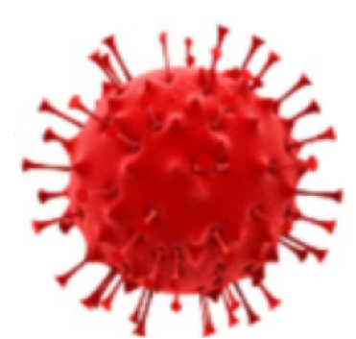

Majac Healthcare vs C VID-19
Aged Care
C VID-19 vs Hypochlorous Acid - SHIELDme
C VID-19 VS Vaccination
© Majac Medical Products P/L
Ph: +61 07 3265 6355. 1300-138-578

Slide 2

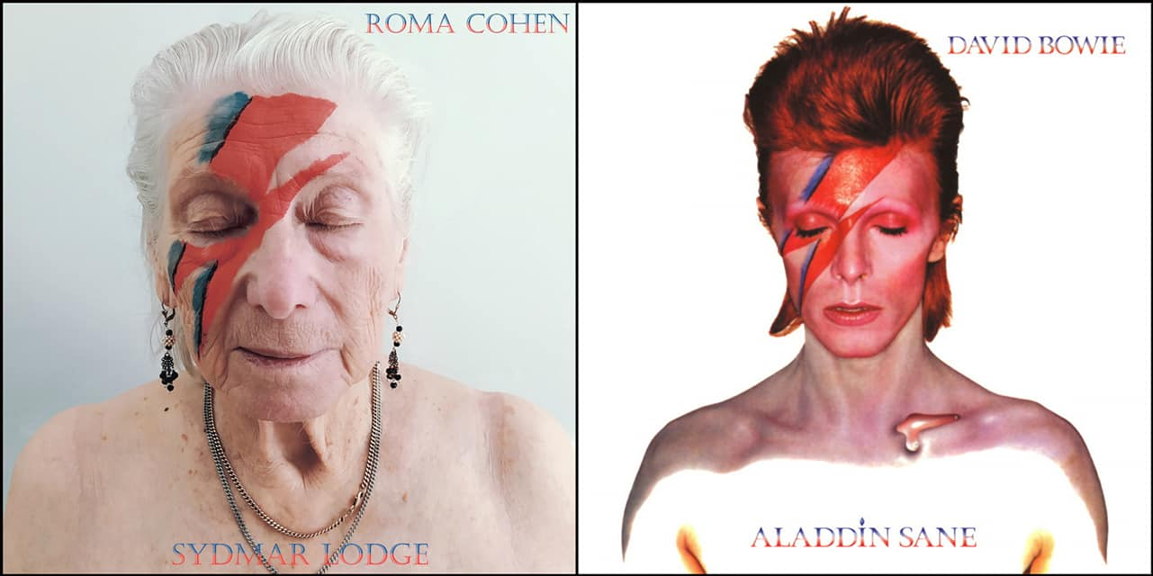
C VID-19 vs Hypochlorous Acid
SHIELDme Kills C VID-19 in 30 Seconds

Slide 3
WHAT ABOUT COVID-19?
COVID-19 is an enveloped, positive-sense, single stranded RNA virus approximately 60 to 140 nm in diameter. The COVID-19 spike, glycoprotein firmly binds to the angiotensin converting enzyme 2 (ACE) receptor, which allows entry into the host cell.
COVID-19 infection creates a cytokine storm, severe pneumonia, multiple-organ failure, and acute cardiac injury. The coronavirus that causes COVID-19 has protein spikes on each viral particle. These spike proteins allow the virus to attach to cells and cause disease. (slide 10).
Transmission occurs through aerosol or touch for spreading of the virus.
A common pathway of spreading this virus is through respiratory aerosols from an infected person. During speech, humans emit thousands of oral fluid droplets per second that can remain airborne for 8 to 14 minutes. COVID-19 is detectable for up to 3 hours in surface aerosols, for up to 4 hours on copper, for up to 24 hours on cardboard and for up to 2 to 3 days on plastic and stainless steel.9,10
There is a need to disinfect surfaces potentially exposed to COVID-19 to prevent transmission.
From Wuhan to Melbourne, New York to Delhi COVID-19 became a global nightmare.

Slide 4
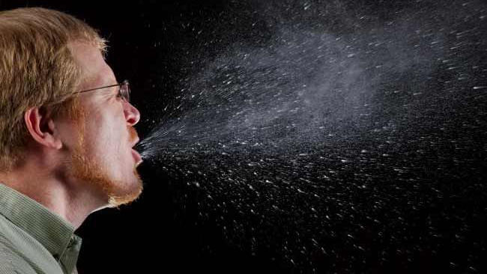
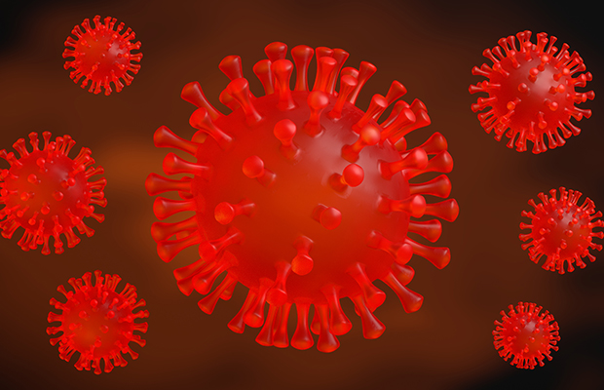
^{AIRBORNE - AEROSOL}
^{www.majacmedical.com.au}

Slide 5
IMPORTANCE OF AEROSOL SIZE TO DISINFECTION AND APPLICATION
Individuals working in the dental and medical field using surgical and high-speed handpieces are at risk from aerosolization.
Aerosols are defined as particles less than 50 µm in diameter.
Particles of this size are small enough to stay airborne for an extended period before they settle on environmental surfaces or enter the respiratory tract may be present in the air of the operator for up to 30 minutes after a procedure.
Particles are classified based on size: Coarse particles measure 2.5 to 10 µm; fine
particles, 0.1 µm to less than 2.5 µm; and ultrafine particles, less than 0.1 µm.
The nose typically filters air particles larger than 10 µm.
If a particle is smaller than 10 µm, it can enter the respiratory system.
If smaller than 2.5 µm , it can enter the alveoli.
A particle smaller than 0. µm, or an ultrafine particle, such as the COVID-19 virus, can enter the bloodstream or target the lungs.

Slide 6
Transmission - Aerosol – Small Particles
Sotiriou et al showed that the concentrations of small particles (<0.5 µm) generated during dental drilling procedures were much higher than the concentrations of larger particles (>1 µm).
Ultrasonic and sonic transmission during nonsurgical procedures had the highest incidence of particle transmission, followed by air polishing, air-water syringe, and high-speed handpiece aerosolization. One study found that ultrasonic instrumentation can transmit 100,000 microbes/ft with aerosolization of up to 6 ft and, if improper air current is present, microbes can last anywhere from 35 minutes to 17 hours.
The ability of a sprayer to make smaller particles may help a solution’s molecules to be suspended in the air for a longer period because of their low settling velocity rate.
This may increase the solution’s chance of coming into contact with pathogens and inactivating them.
Thus, the dispenser applicator (spray or fogger) used should have an aerosol size less than 20µm.

Slide 7
Transmission - Aerosol - Particles
Implications of infectious aerosol data for infection control practice
Because of the large number of patients in health-care settings, health-care workers are likely to have frequent exposures to highly infectious cases.
They might also have more cumulative inhaled doses and infections, although it is unknown if this is involved in the pathogenesis of COVID-19.
Infection control measures might not only reduce the probability of infection, but might also reduce the size of the inhaled inoculum, which has been associated with disease severity in influenza 118,119 and other diseases.120
This might be especially important for small particle aerosols, as 1 µm aerosols of Bacillus anthracis caused higher mortality in animals than 12 µm aerosols in a seminal study.121
Lancet Respir Med 2020; 8: 914–24. Dr Kevin P Fennelly, Pulmonary Branch, Division of Intramural Research, National Heart, Lung, and Blood Institute, National Institutes of Health, Bethesda, MD 20892, USA

Slide 8
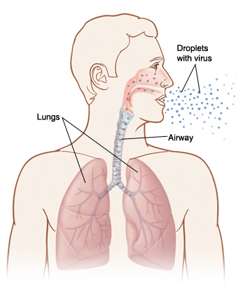
TRANSMISSON - AEROSOL
Infectious aerosols are particles with potentially pathogenic viruses, bacteria, and fungi suspended in the air, which are subject to the same physical laws as other airborne particulate matter.
The biology of the pathogens predicts their airborne survival, infectivity,
virulence, and other characteristics.
Particle size is the most important determinant of aerosol behaviour.
COVID-19, is transmitted by both small and large particle aerosols.
Our body has some natural defence but when the size is from
0.3 to 5 µm (Micron) then the micro-organisms may traverse the naso-pharyngeal airway on each inspiratory effort then via the bronchi to the lungs and alveoli.

Slide 9

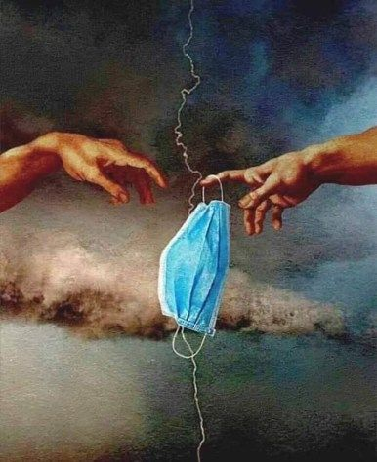
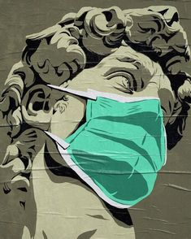
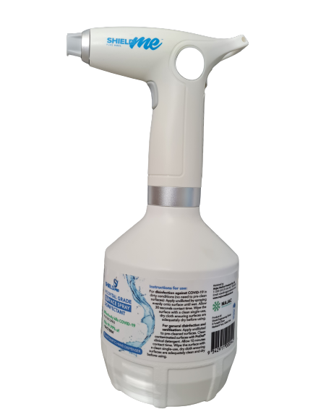
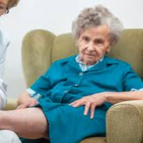
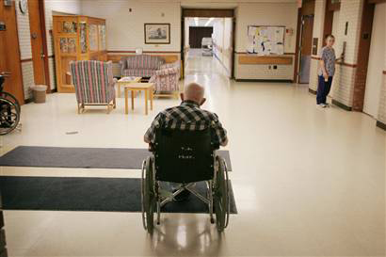
Transmission - AEROSOL & CONTACT
The core principle of infection prevention and control is
to prevent the transmission of infectious organisms and
manage infections if they occur.
The underpinning key practice principles include:
an understanding of the modes of transmission of infectious agents and an overview of risk management
effective work practices that minimise the risk of
selection and transmission of infectious agents.
3. governance structures that support the implementation, monitoring and reporting of infection prevention and control work practices, and
4. compliance with legislation, regulations and standards relevant to infection prevention and control.
NHMRC (2010) Australian guidelines for the prevention and control of infection in healthcare, Commonwealth of Australia
Guidelines: Infection prevention and control | Podiatry Board Australia | 4 April 2016
HOCl
KILLS
C VID
in 30 Seconds

Slide 10
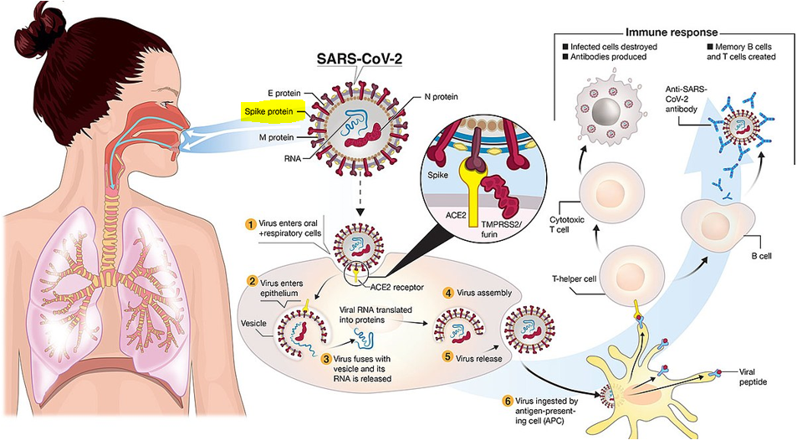







Slide 11

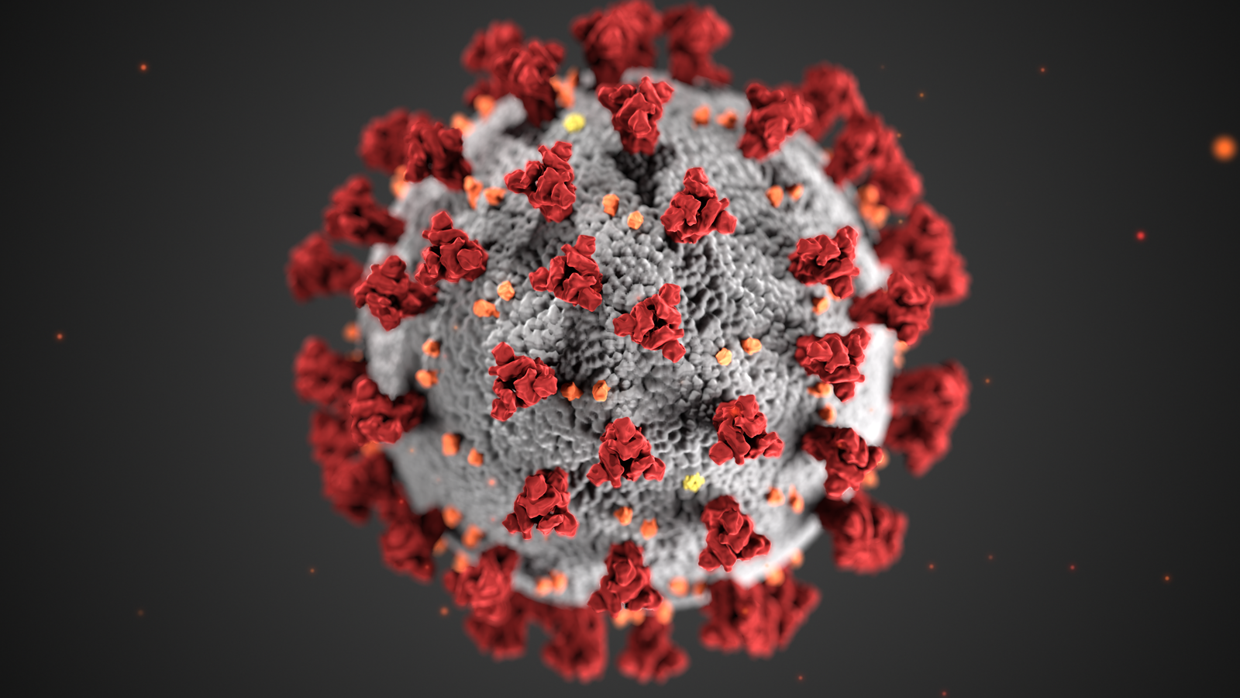
Cytokine storm !
The phenomenon where the body releases too
much cytokine is called Cytokine Storm.
A severe immune reaction in which the body releases
too many cytokines into the blood too quickly.
Cytokines play an important role in normal immune
responses, but having a large amount of them released in the body all at once can be harmful.
A cytokine storm can occur as a result of an infection, autoimmune condition, or other diseases.
It may also occur after treatment with some types of immunotherapy.
Signs and symptoms include high fever, inflammation (redness and swelling), and severe fatigue and nausea. Sometimes, a cytokine storm may be severe or life threatening and lead to multiple organ failure.

Slide 12
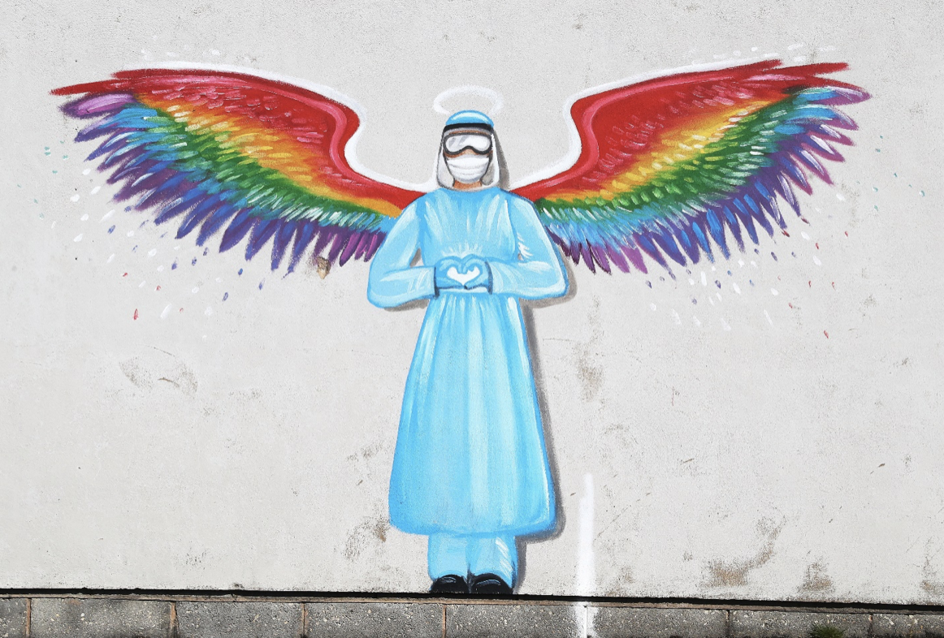
HYPOCHLOROUS ACID: A REVIEW
Michael S. Block, DMD and Brian G. Rowan, DMD, MD.
The surgeon needs to have an inexpensive, available, nontoxic, and practical disinfectant that is effective in sanitizing against the COVID-19 (Coronavirus Disease 2019) virus.
The purpose of this article was to review the evidence for using hypochlorous acid in the office setting on a daily basis. The method used to assemble recommendations was a review of the literature including evidence for this solution when used in different locations and industries other than the oral-maxillofacial clinic facility.
The results indicate that this material can be used with a high predictability for disinfecting against the COVID-19 (Coronavirus Disease 2019) virus.
© 2020 American Association of Oral and Maxillofacial Surgeons
J Oral Maxillofac Surg 78:1461-1466, 2020. Many thanks.

Slide 13
HYPOCHLOROUS ACID (HOCl) V OTHER DISINFECTANTS Stepping away from the Ethanol, QUAT (Quaternary Ammonium Compound), Hydrogen Peroxide (H2O2) and Chlorine (Sodium Hypochlorite) based disinfectants. HOCl is 100% natural, non-toxic and formulated from Hypochlorous Acid (HOCl) which is also created within our own human immune system. White blood cells (Neutrophils) generate this acid as part of their arsenal to respond and attack bacteria and viruses WITHIN OUR BODIES – known as phagocytosis. Don’t let the acid part of the name intimidate you; HOCl specifically targets only bacteria, viruses, making it suitable for use around humans, animals and the environment. Scientifically, tested to have a kill time of 30 seconds for COVID-19 and proven to be 99.99% effective against bacteria.*(tested against P.aeruginosa. E. coli, S. aureus, E. hirae). *(tested against F.Calcivirus, H.Simplex).

Slide 14
USE OF DISINFECTANTS
On contact with micro-organisms, a disinfectant agent changes the protective protein coat, which loses its structure and aggregates, forming clumps of proteins with other viruses.
Some proteins maybe hydrophobic, some hydrophilic.
Currently, the US Environmental Protection Agency has recommended numerous disinfectants against COVID-19 including hypochlorous acid (HOCl).
The mechanism of disinfection involves the destroying of the cell wall of microbes or viruses, allowing the disinfectant to destroy or inactivate them.
This presentation focuses on HOCl. – Hypochlorous Acid.
HOCl is a powerful oxidizing agent. In aqueous solution, it dissociates into H+ and OCl–, denaturing and aggregating proteins.
HOCl also destroys viruses by chlorination by forming chloramines and nitrogen centered radicals, resulting in single - as well as double-stranded DNA breaks,
rendering the nucleic acid useless and the virus harmless.

Slide 15
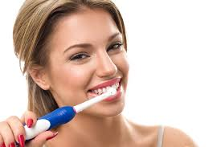
BIOFILM
HOCl IS effective for cleaning biofilm contaminated implant surfaces.
HOCl significantly lowered the lipopolysaccharide concentration of prohormones gingivalis when compared with sodium hypochlorite and chlorhexidine and was well tolerated by the oral tissues.
HOCl significantly reduced bacteria on tooth brushes; it was
effective as a mouthwash and for toothbrush sanitization.
SURFACE APPLICATION
A study looked at disinfecting outpatient surgical centers using
HOCl.55 After cleaning, the rooms in the HOCl cleaning and
disinfection study arm had significantly lower bacterial counts
than the rooms that underwent standard cleaning and disinfection .

Slide 16
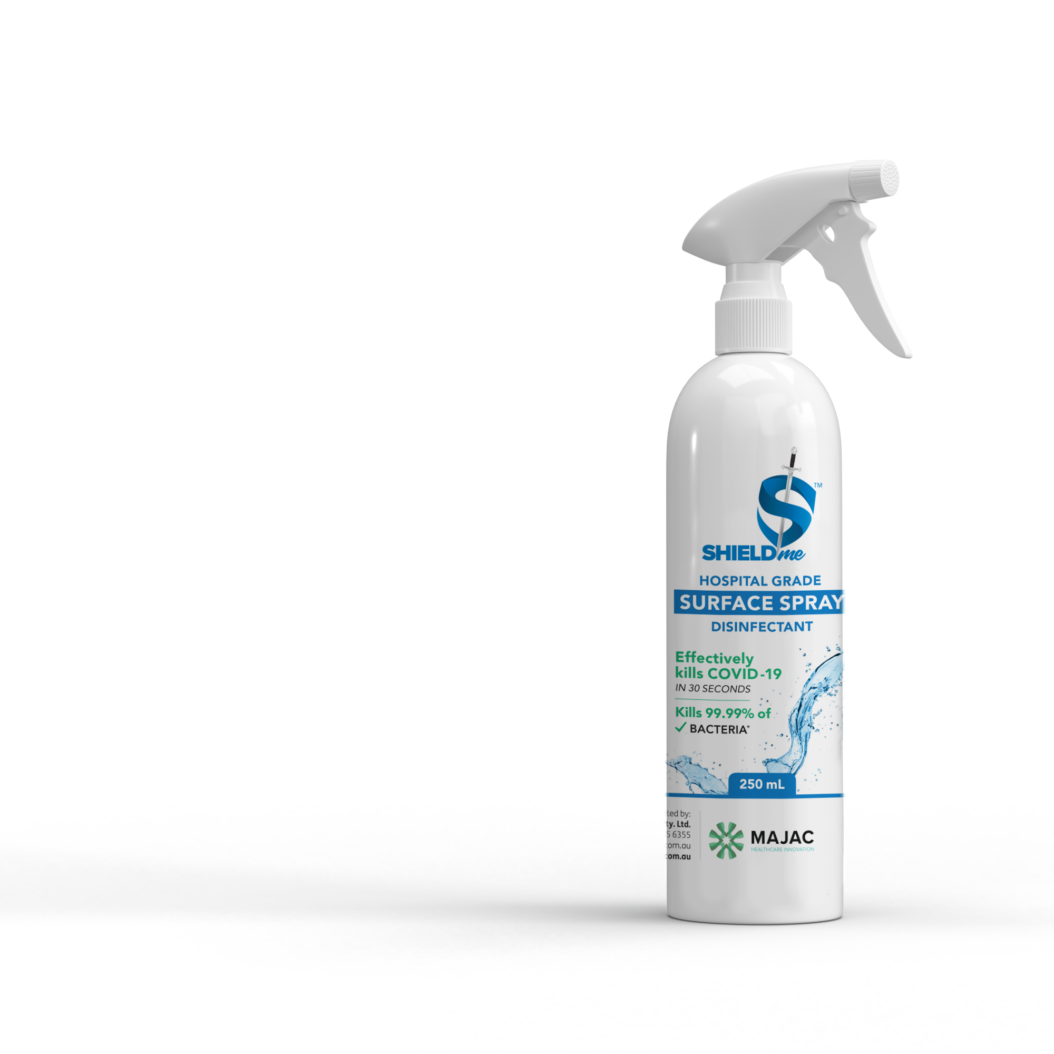
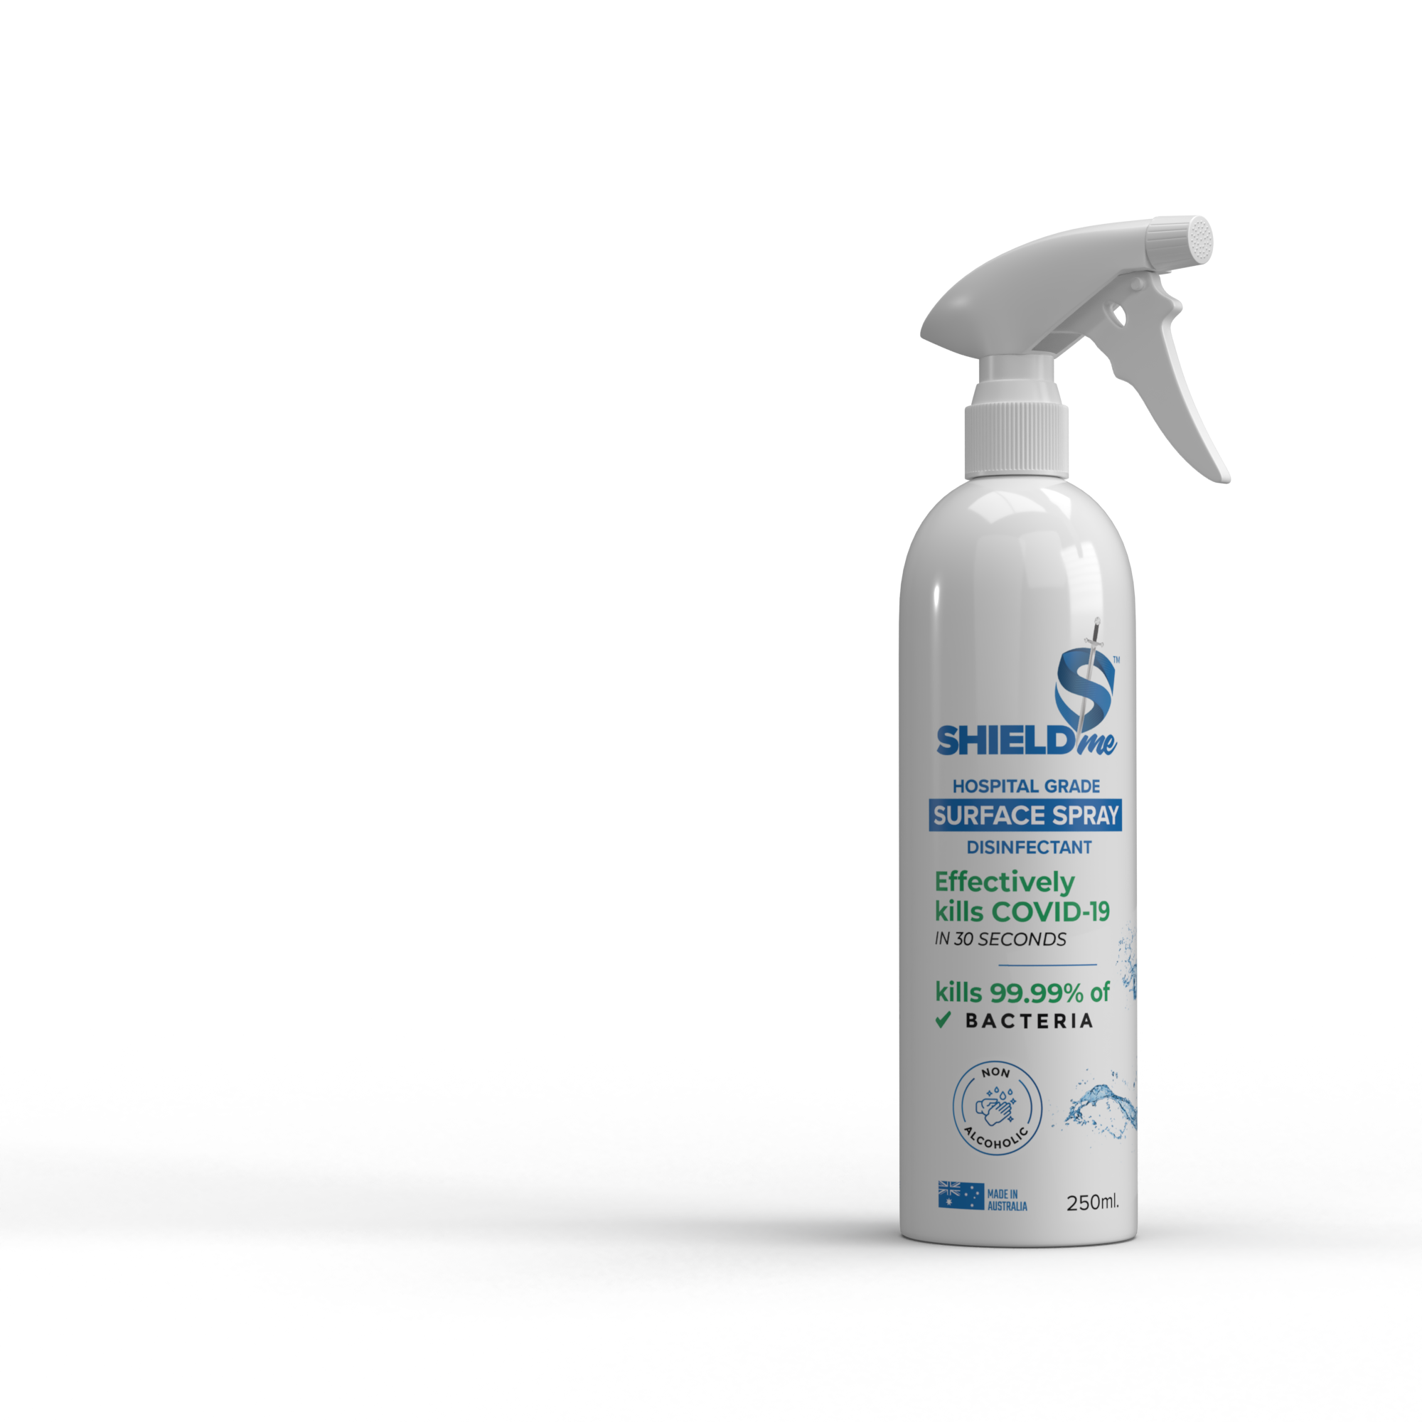
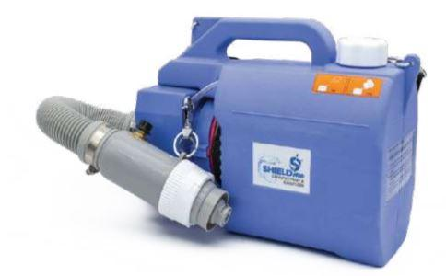
AEROSOL and SURFACE - APPLICATION
HOCl Applied by Spray or Fogger
A spray or fogger takes a solution and creates a small aerosol ideally less than 20 mm in size, to disinfect an area.
HOCl sprays & fogs are highly effective in the microbial disinfection of surfaces.
The ability of a sprayer to make smaller particles may help a solution’s molecules to be suspended in the air for a longer period because of their low settling velocity rate.
This may increase the solution’s chance of coming into contact with pathogens and inactivating them. Thus, the fogger used should have an aerosol size less than 20 mm
Surface Application
A study looked at disinfecting outpatient surgi-centres using HOCL. After cleaning, the rooms in the HOCl cleaning and disinfection study had signiﬁcantly lower bacterial counts than the rooms that underwent standard cleaning and disinfection.
When HOCl solutions were sprayed directly onto sheets containing the virus for 10 seconds, the solutions of 100 and 200 ppm inactivated AIV.
250ML 500ml 1 litre - auto rechargeable 5 L High-power motor, high speed spraying
100% NATURAL
NO CHEMICALS
NO ALCOHOL
NON TOXIC

Slide 17
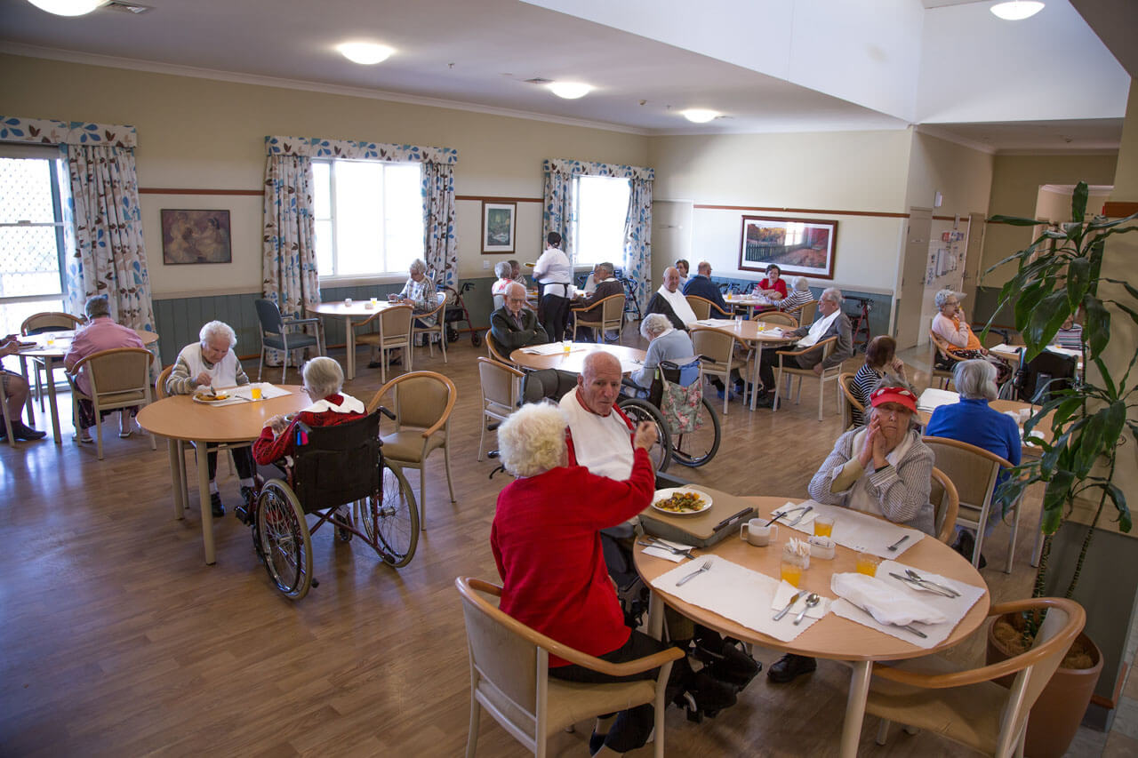
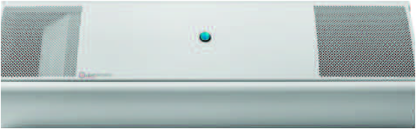
Transmission Aerosol - COVID-19
HOCl
UVGI AIR - SANITIZER
Low Cost
Safe for humans
“Just Perfect”
Handheld Auto Sprayer 1Litre
Mist to Jet – Rechargeable Battery
for speedy disinfection

Slide 18
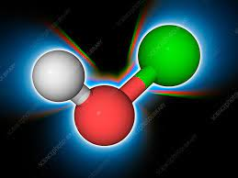
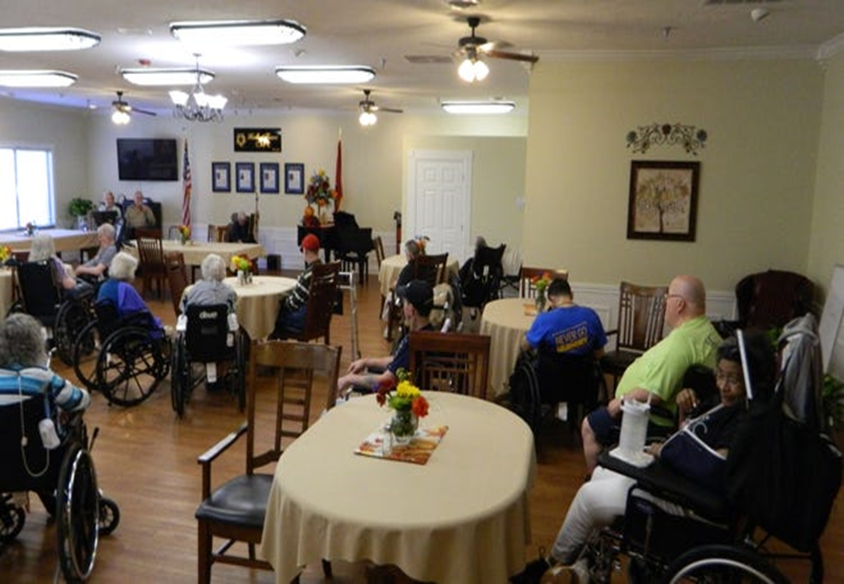
Transmission Aerosol & Contact
UVGI AIR - SANITIZER
HOCl
“Just Perfect”
for speedy disinfection
Handheld Auto Sprayer 1Litre
Mist to Jet – Rechargeable Battery
Safe
non toxic
no alcohol

Slide 19
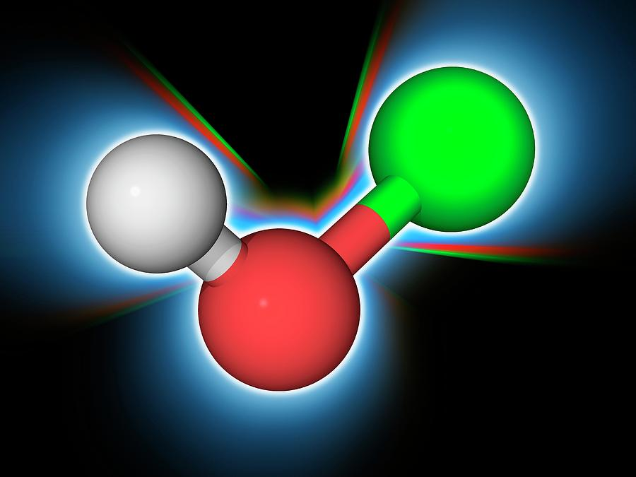
UVGI AIR - SANITIZER
Handheld Auto Sprayer 1Litre
Mist to Jet – Rechargeable Battery
“Just Perfect”
for speedy disinfection
HOCl

Slide 20
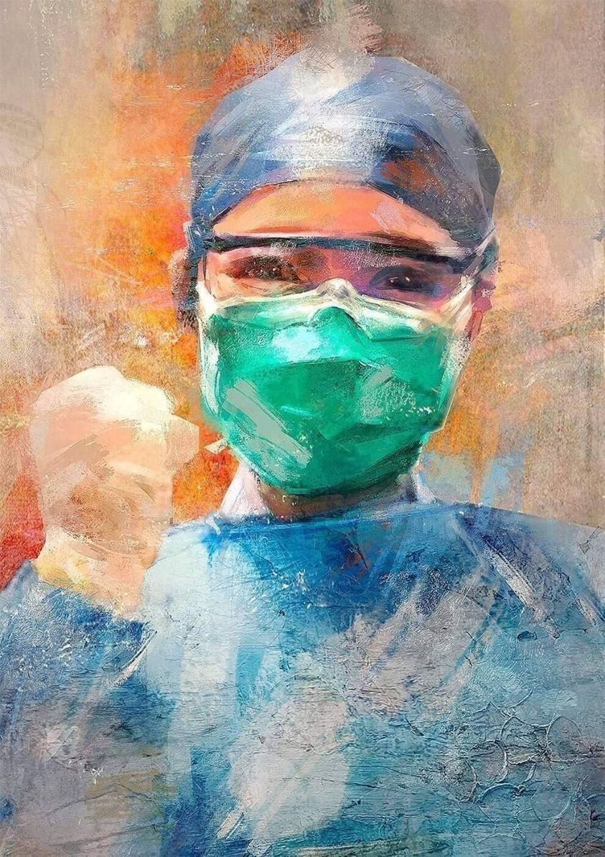


SHIELDme is a COMPLETE SOLUTION.
Kills CO VID-19 in 30 Seconds
SAFE ON HUMANS
KILLS 99.99% OF VIRUSES & BACTERIA
NO ALCOHOL
ECO-FRIENDLY

Slide 21
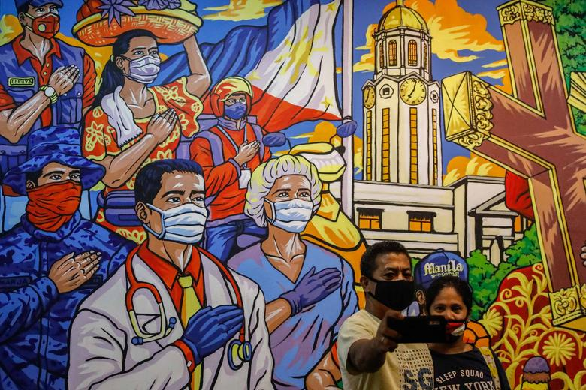

Made in
WHAT IS SHIELDme MADE OF?
HOCl
SAFE FOR HUMANS
NON TOXIC
SAFE FOR ENVIRONMENT
100% NATURAL
ENTIRELY FREE OF ALCOHOL
SAFE FOR HUMANS
NO CHEMICALS NON-CORROSIVE

Slide 22
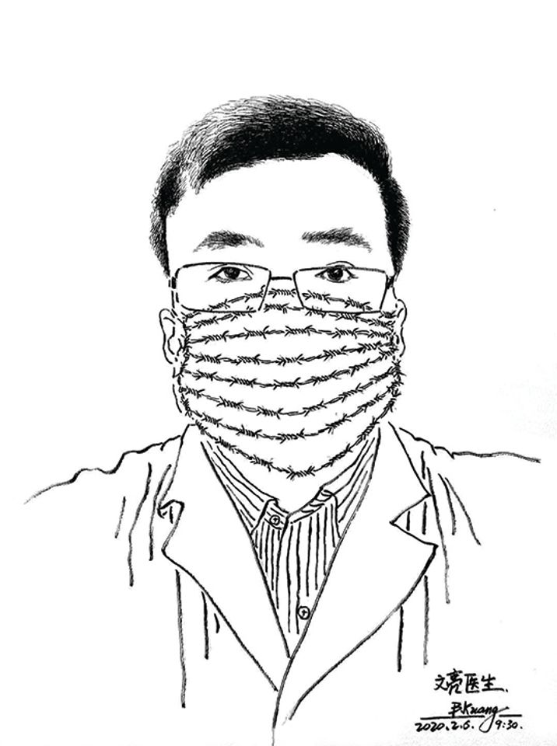
HOW DOES SHIELDme (HOCl) WORK?
SHIELDmeTM works by the power of HOCl - one of the most potent disinfectants known, and one which occurs naturally in the human body.
Protect your premises, staff and patients.
Kills 99.99 % of Bacteria & Viruses
COVID-19 in 30 Seconds
*(tested against P.aeruginosa. E. coli,
S. aureus, E. hirae).
*(tested against
F.Calcivirus,H.Simplex).

Slide 23

INTERNATIONALLY CERTIFIED & TESTED.
ACHIEVING 99.99% KILL RATE ON BACTERIA & VIRUSES.
COVID-19 IN 30 SECONDS
Handheld Auto Sprayer 1Litre
Mist to Jet – Rechargeable Battery
for speedy & disinfection
Tested & Certified in Australia ARTG 34341

Slide 24
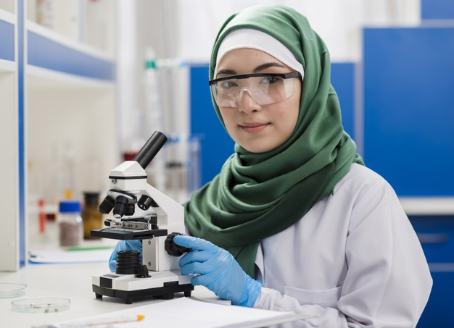

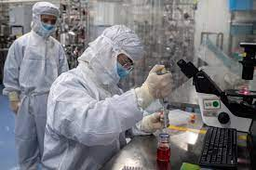
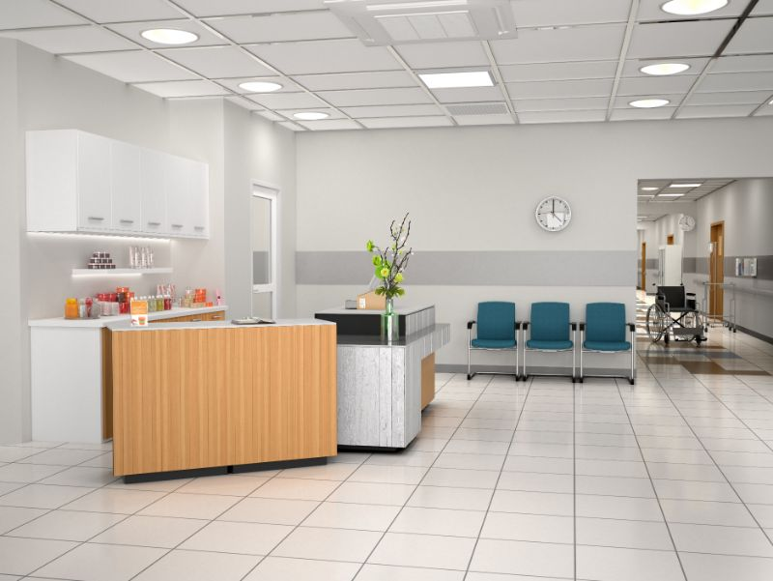
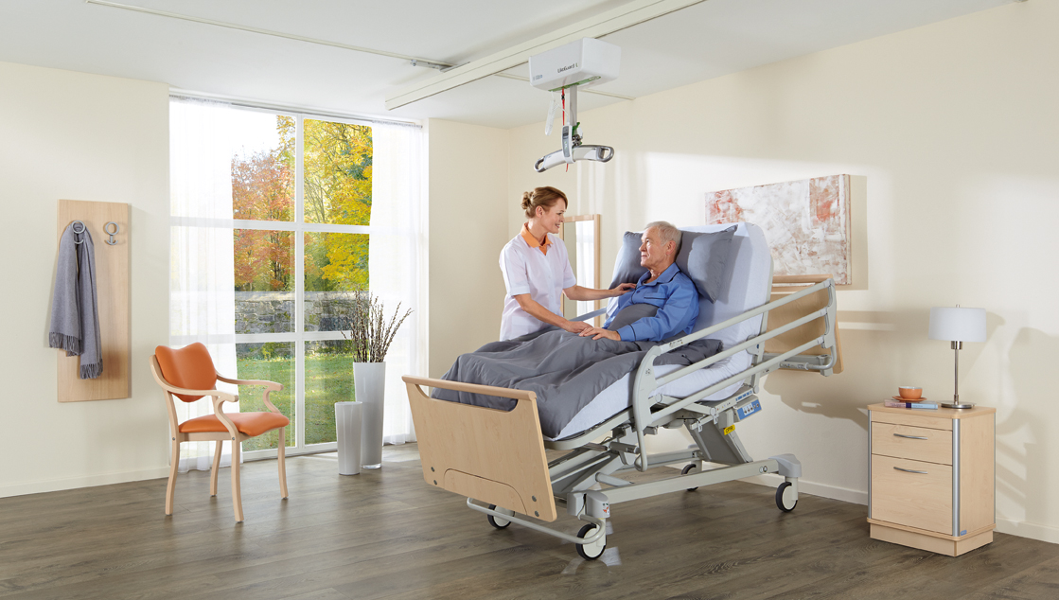
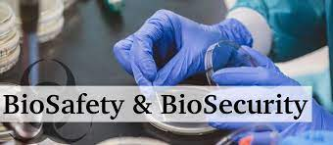
SCIENCE & TECHNOLOGY - BEHIND PRODUCTION PROCESS
Production process is grounded in continuous scientific testing & improvements.
SCIENCE INVENTS
HOCl
TECHNOLOGY
DELIVERS

Slide 25

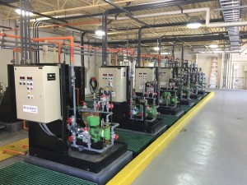
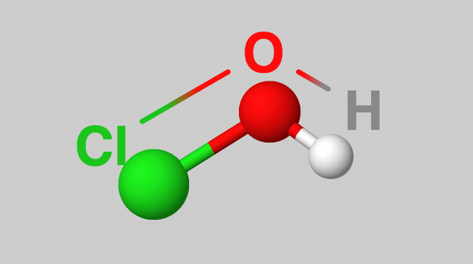
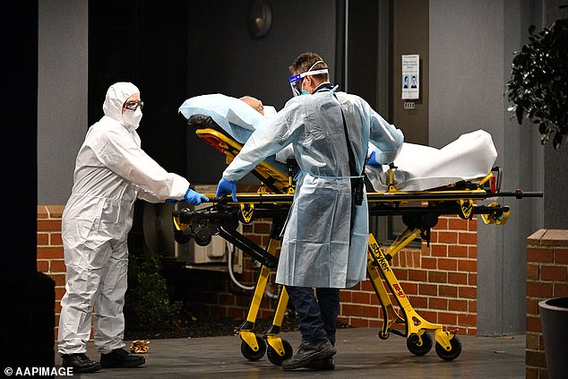
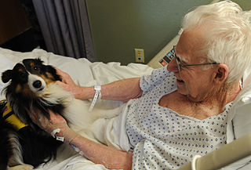

SCIENCE & TECHNOLOGY - BEHIND PRODUCTION PROCESS
Production process is grounded in continuous scientific testing & improvements.
SCIENCE INVENTS
HOCl
TECHNOLOGY
DELIVERS

Slide 26
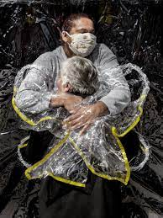
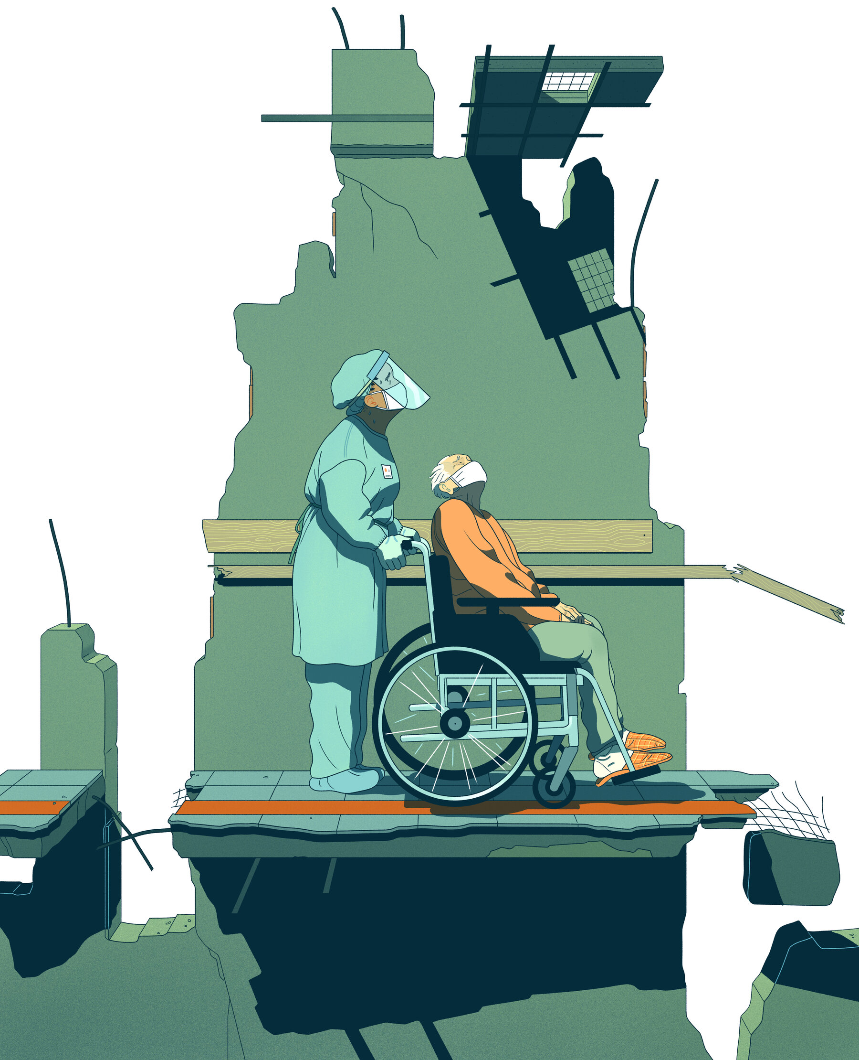
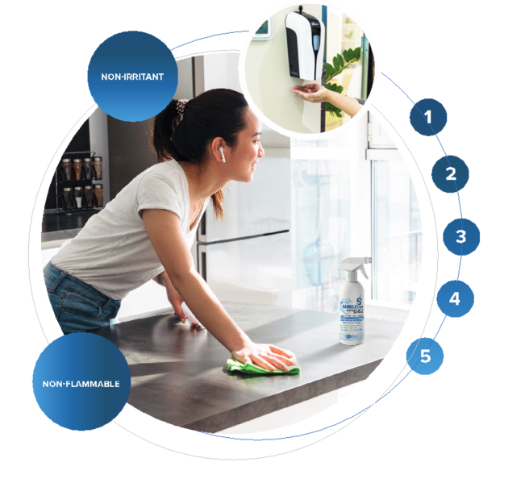
MORE BENEFITS
A total complete solution for all
disinfecting requirements.
Enhanced microbial and biofilm control provides confidence that organizations are offering quality assured products.
Can be fogged at low concentrations to ensure cost-effective surface decontamination.
Easy and safe to apply, requiring no special handling procedures or safety equipment.
No harmful chemicals needs to be sorted, processed or disposed of post cleaning of the premises.

Slide 27
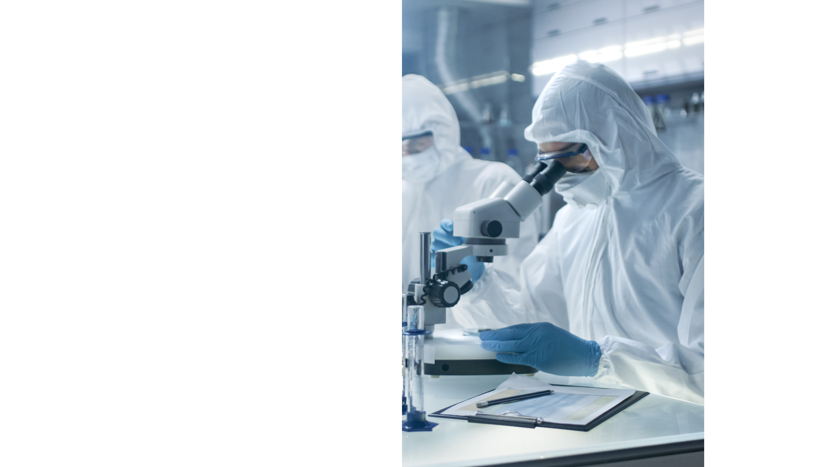
ACCREDITTED BY GLOBAL LEADING LABORATORIES

Slide 28
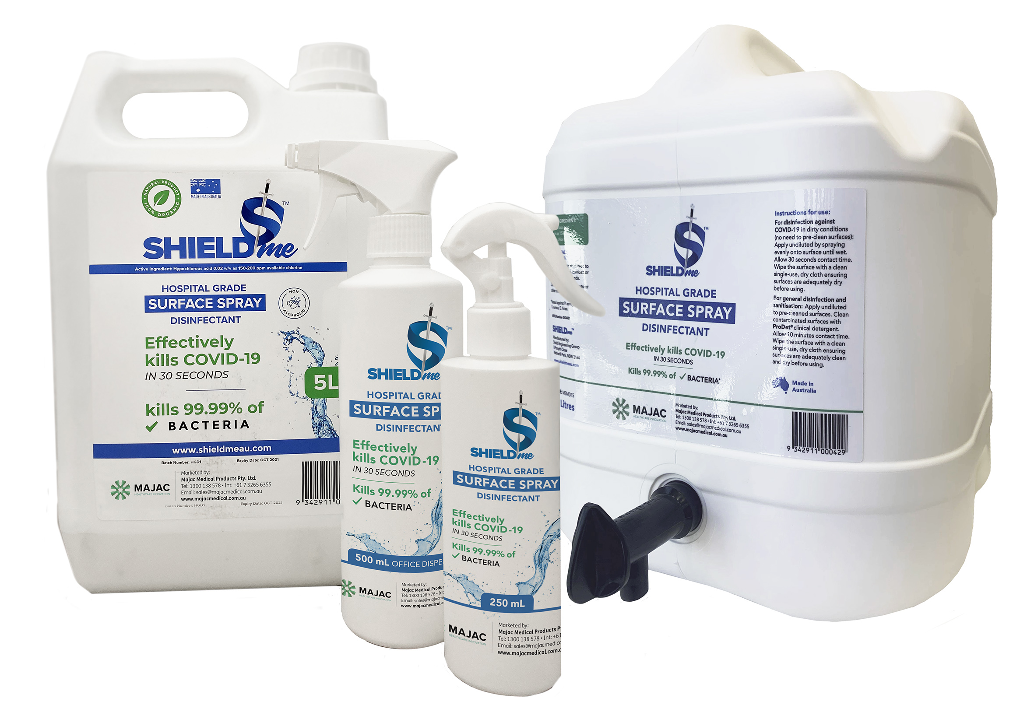
SHIELDmeTM HOSPITAL GRADE DISINFECTANT
THE NEW “STATE OF THE ART” DISINFECTANT
.
^{SAFE TO USE ANY WHERE}
^{NON-TOXIC}
^{NO ALCOHOL}
^{NON HAZARDAROUS}
^{EFFECTIVE YET INEXPENSIVE}
15 Litre Container - MSMD15
5 Litre Container - MSM05
500 ml Dispenser – Empty MSM500E
250 ml Dispenser - MSM250
Handheld Auto Sprayer 1L - MSM1L
Handheld Auto Sprayer 1Litre
Mist to Jet – Rechargeable Battery
“Just Perfect”
for speedy disinfection
^{www.majacmedical.com.au}

Slide 29
HAND SANITIZERS
Hand sanitizers are alcohol based or non–alcohol based containing
antibiotic compounds.51 Chlorine based sanitizers, at a concentration
of 50 to 100 ppm, are effective against bacteria and viruses.
HOCl specifically used for hand sanitizers is effective at 100-200-ppm
strengths.
Hypochlorous Acid: A Review. Michael S. Block, DMD and Brian G. Rowan, DMD, MD.
©2020 American Association of Oral and Maxillofacial Surgeons J Oral Maxillofac. Surg. 78:1461-1466, 2020
Elsevier: COVID-19 Resource Centre. Our thanks to them.
(HOCl) is a 100% natural sanitizer which is oxidized water
with Hypochlorous acid 150-200 PPM. Kills 99.99% of bacteria.
SHIELDme Automatic Hand Disinfecting Dispenser
can be used widely inside all buildings, and
wherever a large number of people pass by or congregate.
e.g. entrances, corridors, washrooms, class rooms
www.majacmedical.com.au

Slide 30
C VID-19 vs Vaccination
Protect yourself, the family, friends, workmates, all of us.
Just go get educated on aerosol & contact transmission.
Learn about vaccines.
https://www.health.gov.au/contacts/national-coronavirus-and-covid-19-vaccine-helpline
https://www.health.govt.nz/our-work/diseases-and-conditions/covid-19-novel-coronavirus/covid-19-vaccines
Vaccination is the most effective protection against infectious diseases.
Vaccines strengthen your immune system. Vaccines train your body to fight the specific viruses.
To globally achieve herd immunity a high percentage of the population has to be vaccinated.
Vaccination reduces the risk of catching and transmitting
“Let’s Get it right”

Slide 31
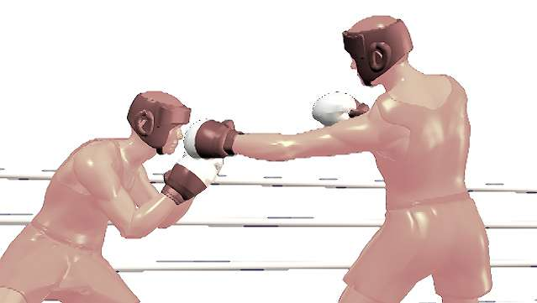
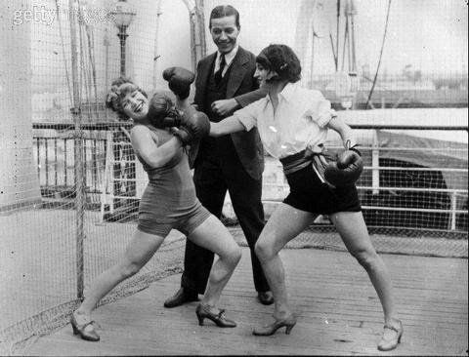

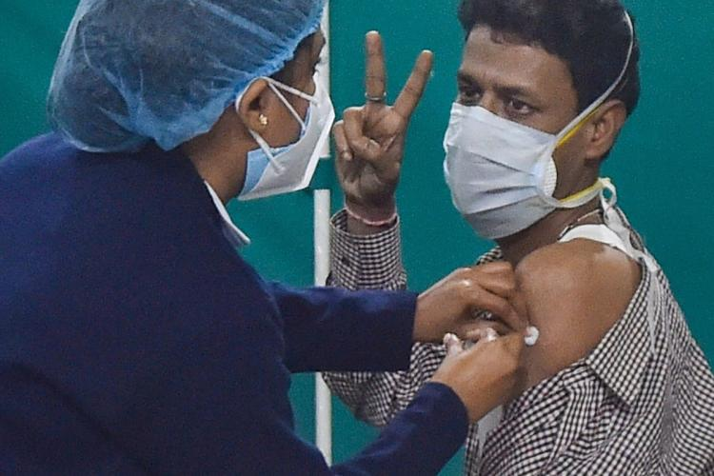
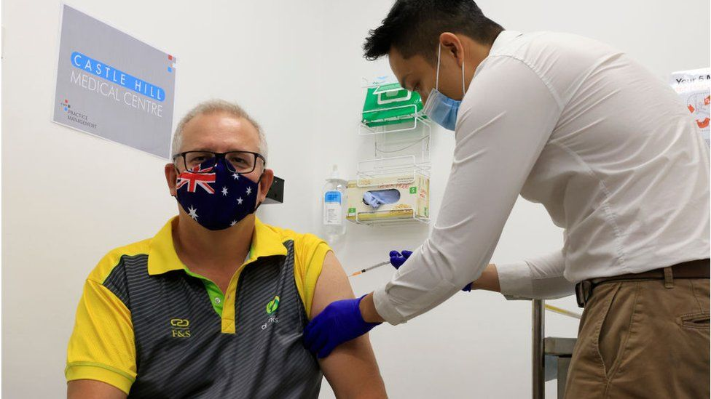
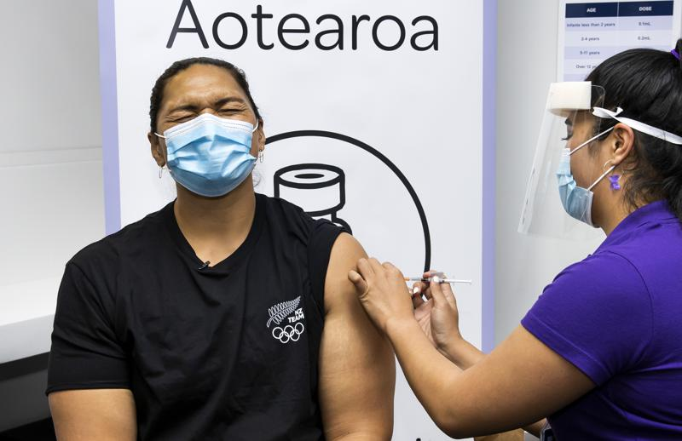
C VID-19 vs Vaccination
For mine! you can all go n get “Jabbed”
Not in the face
Not in the neck
Not in the gut
In the Deltoid
https://www.health.gov.au/contacts/national-coronavirus-and-covid-19-vaccine-helpline
https://www.health.govt.nz/our-work/diseases-and-conditions/covid-19-novel-coronavirus/covid-19-vaccines

Slide 32


Slide 33


We appreciate your attention
and trust this presentation proves of benefit to the clinic,
your staff and patients.
Majac Healthcare
Supports Continuing Education
“Let’s get it right”
Hypochlorous Acid: A Review. Michael S. Block, DMD and Brian G. Rowan, DMD, MD.
© 2020 American Association of Oral and Maxillofacial Surgeons J Oral Maxillofac Surg 78:1461-1466, 2020
Elsevier: COVID-19 Resource Centre. Thank you both for your contribution.
Majac Healthcare acknowledges:

